Slide 1
Year 1
Parent Information
Miss Horner
Mr Field

Slide 2
Welcome to Year 1
Holly and Rowan Class
Meet our team
Holly Class
Rowan Class
Mr Field- Holly Class Teacher
Miss Horner- Rowan Class Teacher
Mrs Mamaniat
Supporting children in Rowan & Holly
Mrs Seedat Miss Hassan
Holly class Teaching assistants
Mrs Chopdat
Rowan Class Teaching Assistant

Slide 3
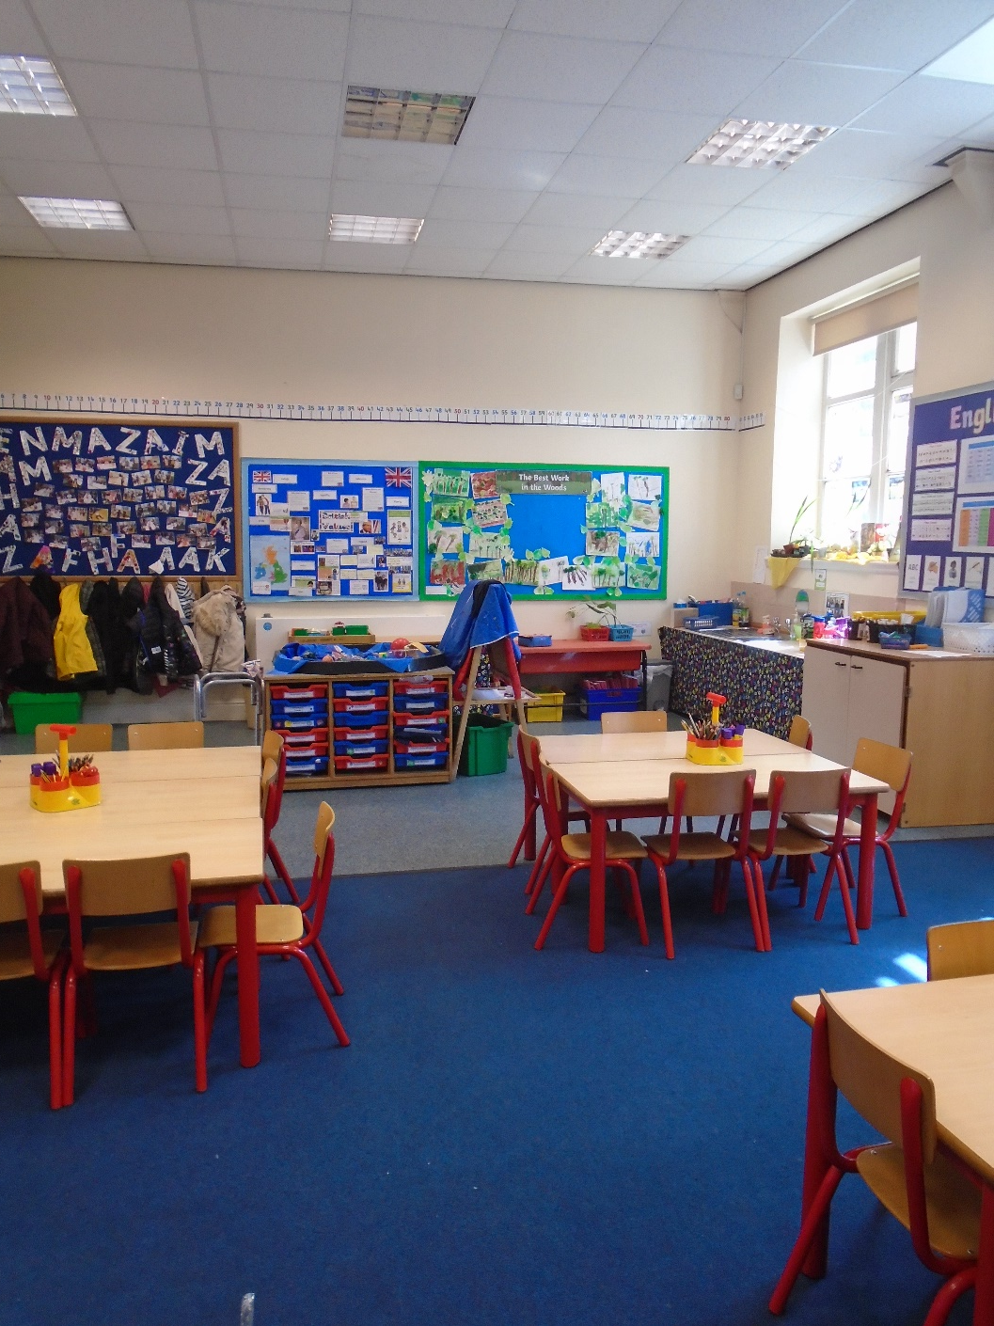
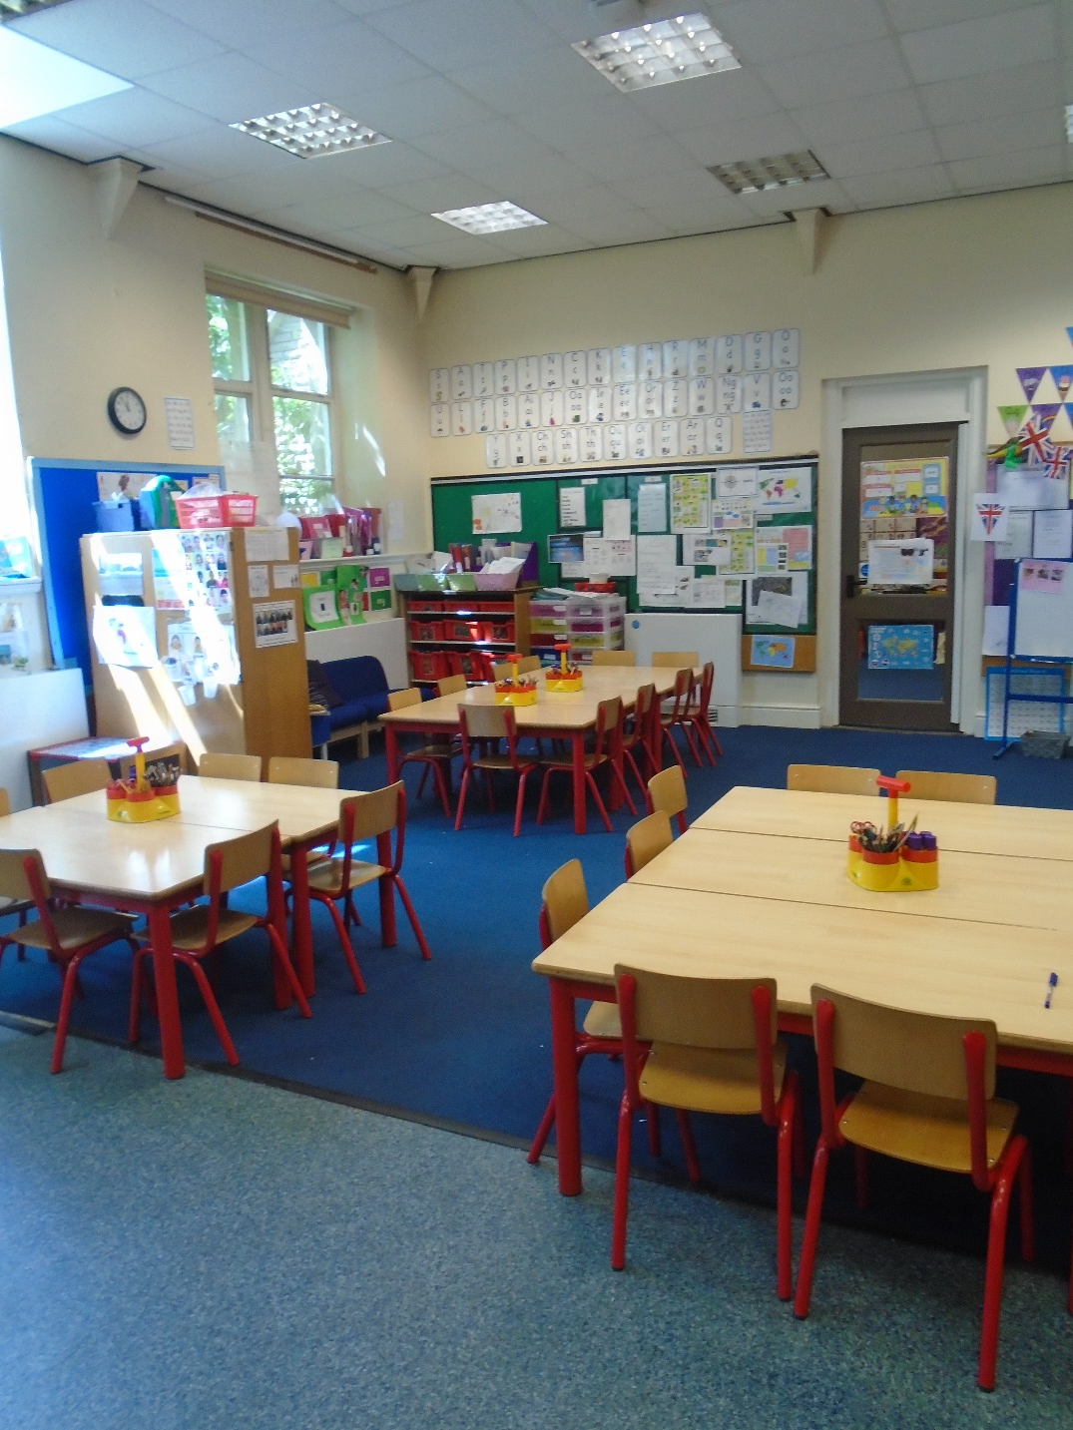
Rowan
Class

Slide 4
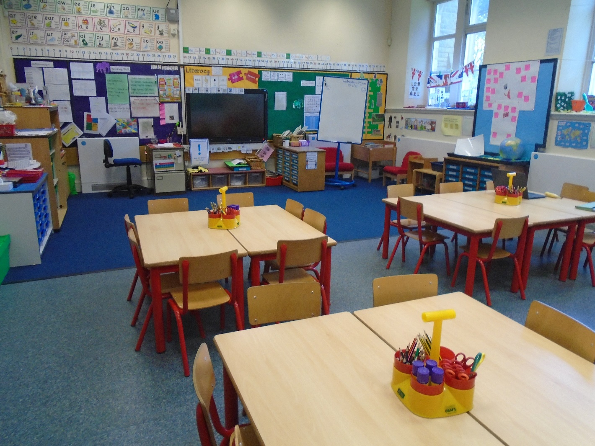
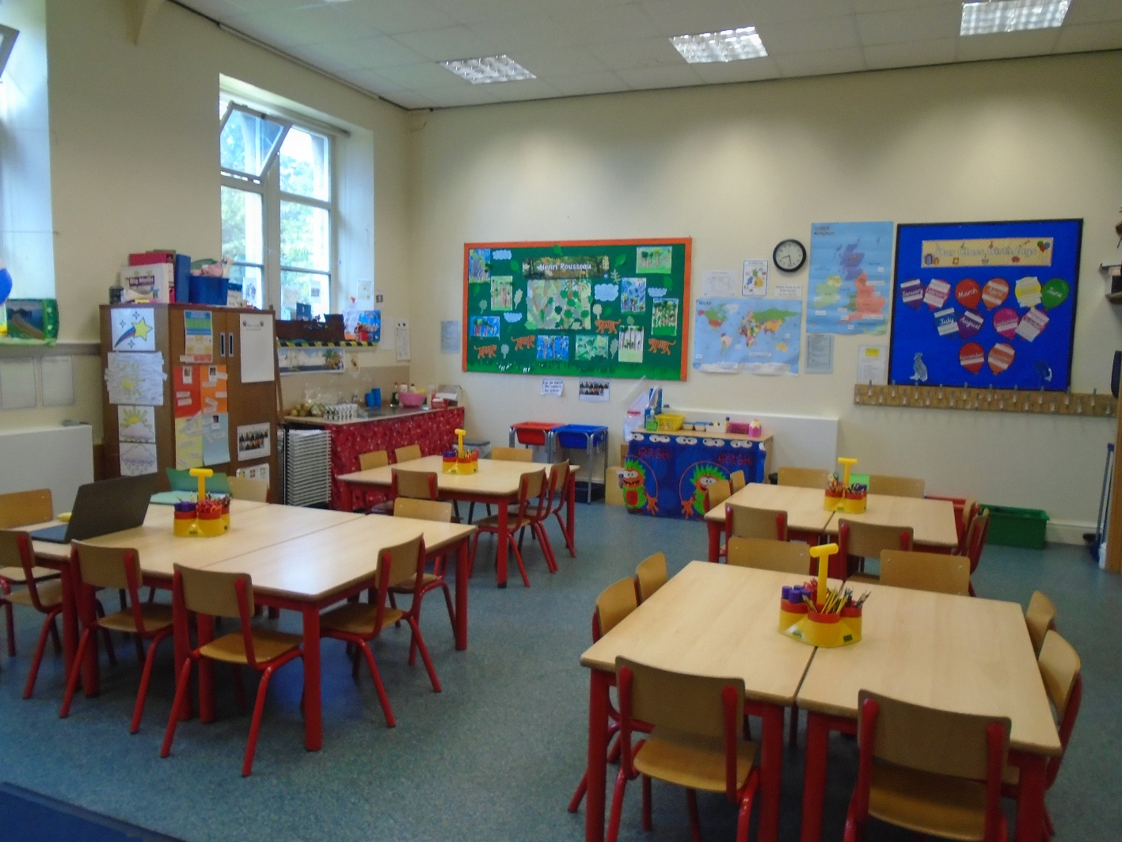
Holly Class

Slide 5
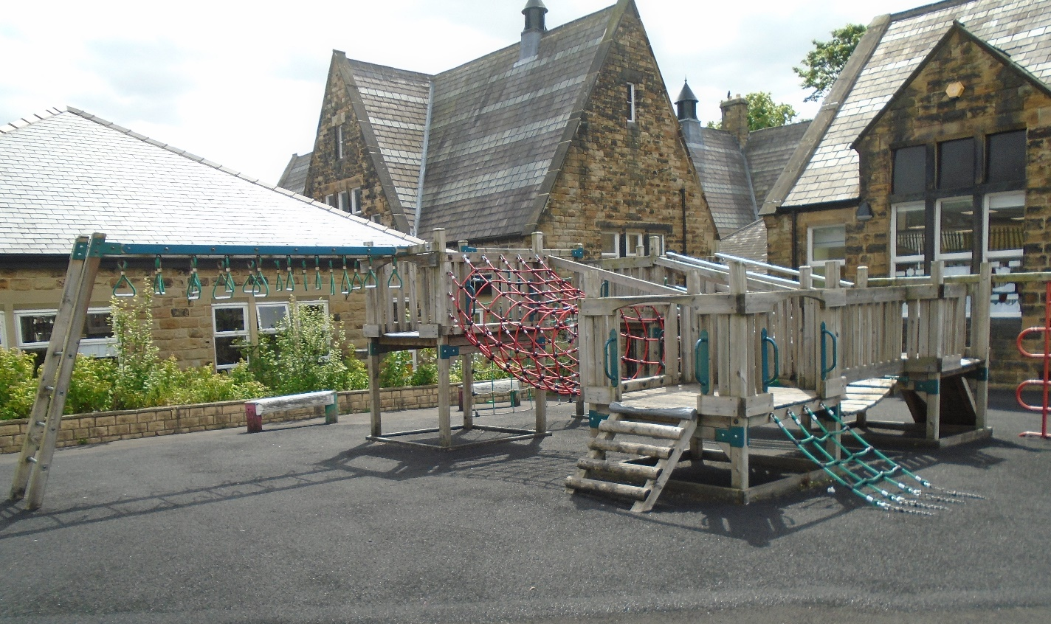
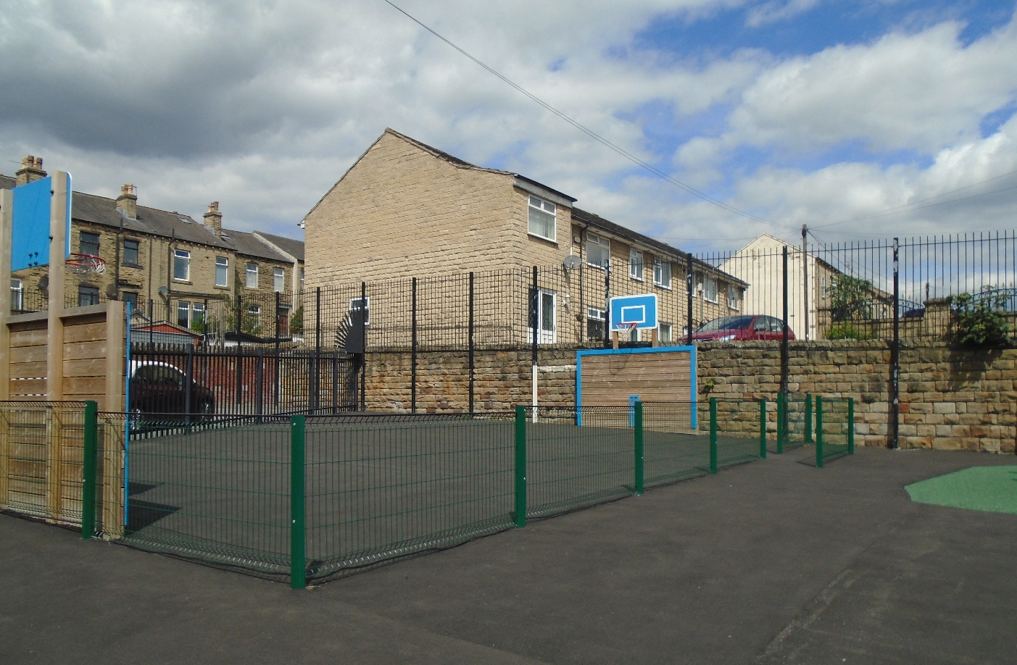
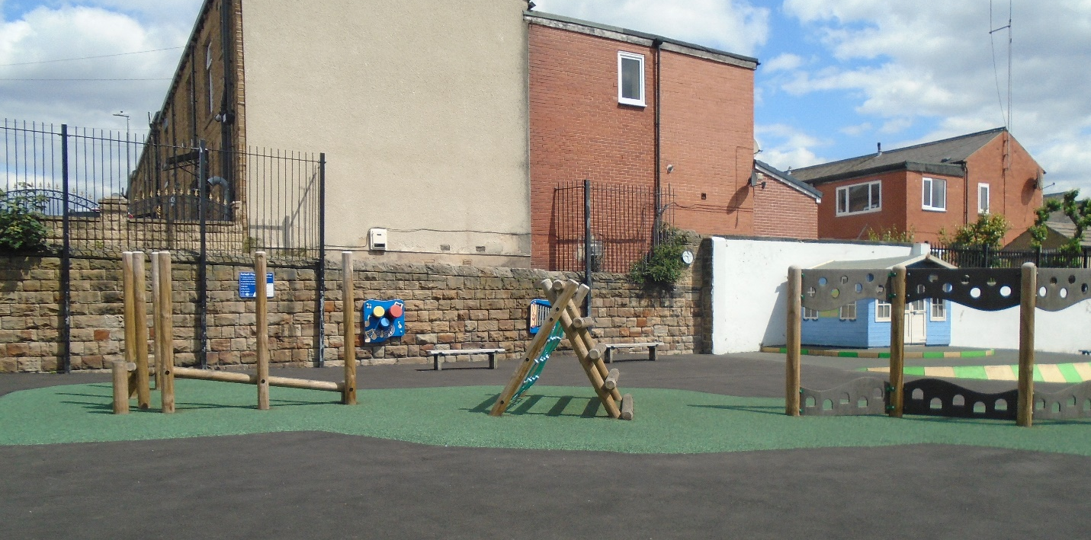
Our Playground

Slide 6
Subjects in the Year 1 curriculum
English
Maths
Science
Phonics
History
Geography
Religious Education (R.E)
Physical Education (P.E)
PSHE
Music
Art/DT
Computing

Slide 7
Phonics
Little Wandle is used across school.
Phonics twice daily.
Little Wandle reading books matched to phonic ability.

Slide 8
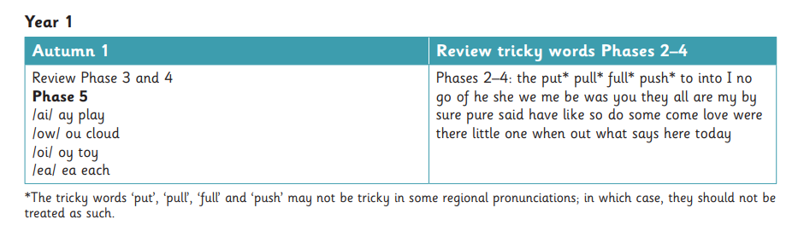
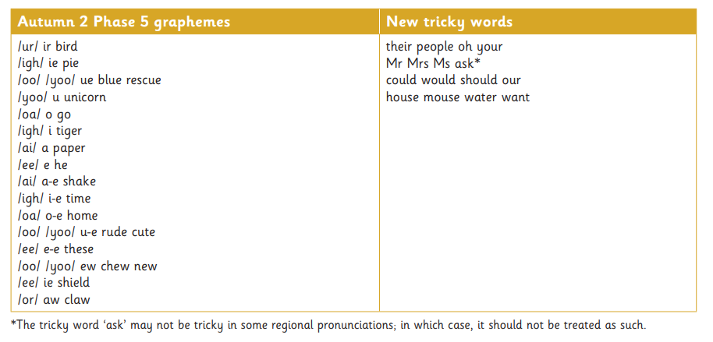
Autumn 1
Autumn 2

Slide 9
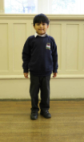
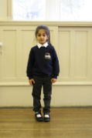
School uniform
White shirt or white polo shirt
Grey trousers or skirt/dress
Navy blue sweatshirt or cardigan
Black shoes or all black trainers
Hair accessories should be kept small and only blue or white.
Summer Uniform
Blue and white checked gingham dress (can be worn with white or blue leggings)
Grey shorts
Sensible footwear – no open toe sandals.

Slide 10
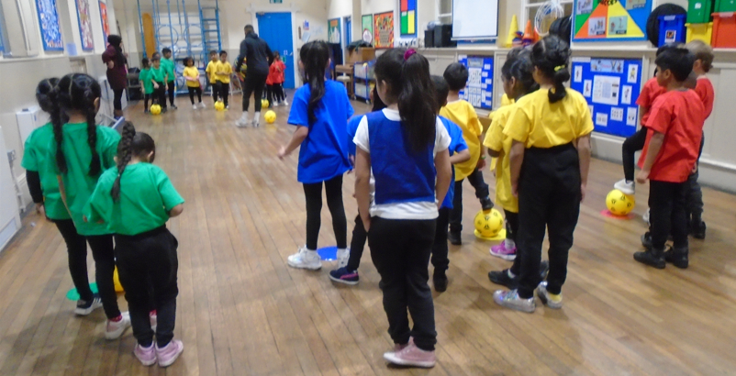
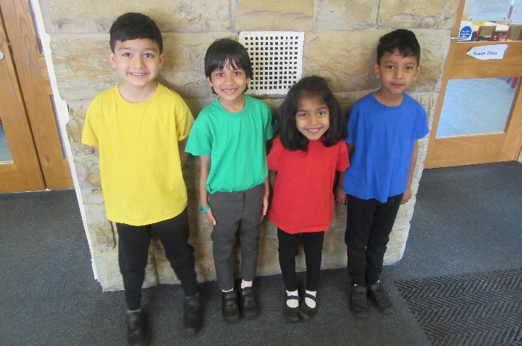
P.E Kit and
P.E days
Children in Year 1 have P.E twice a week (Tuesday and Thursday).
On both PE days, your child will need to come to school wearing their PE kit (coloured t-shirt, black trousers and trainers).
Your child is already part of a coloured team (Ruby, Sapphire, Emerald and Amber). They will remain in the same coloured team throughout their time at Purlwell.
If you would like to purchase a different sized t-shirt, please visit the office as soon as possible so that you can either purchase the sizes we have in stock or you can place an order.
If you would like another t-shirt, please see the office as soon as possible.

Slide 11
Daily essentials:
Water bottle
Book bag (please check regularly for letters).
Planners

Slide 12
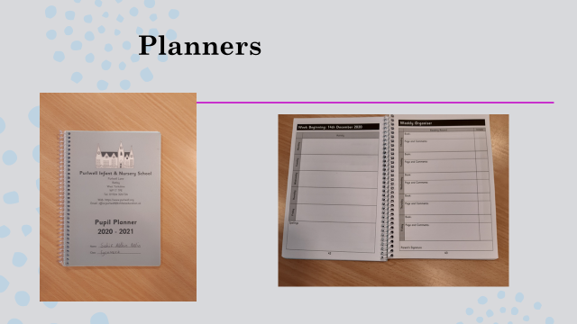

Slide 13
Reading books:
Your child will receive reading book/s weekly.
Please remember to read with your child regularly at home.

Slide 14
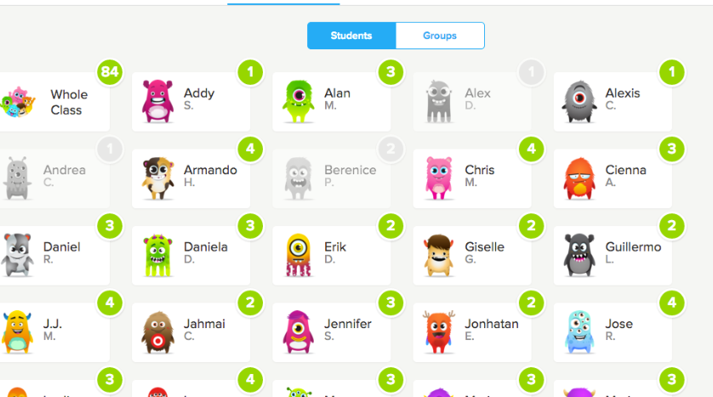
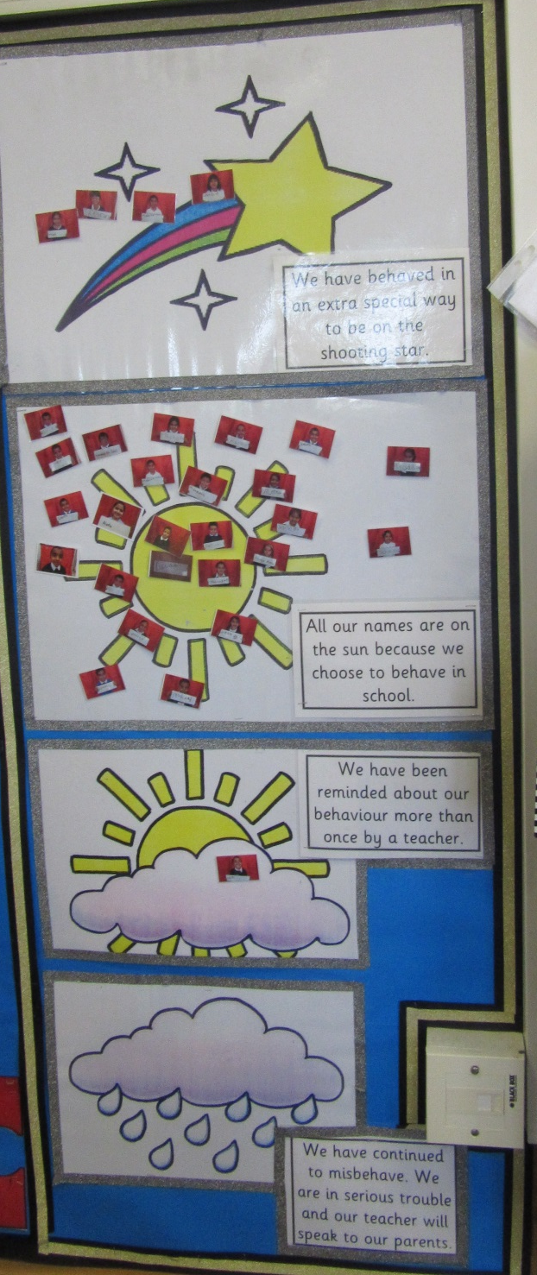
Behaviour system in year 1

Slide 15
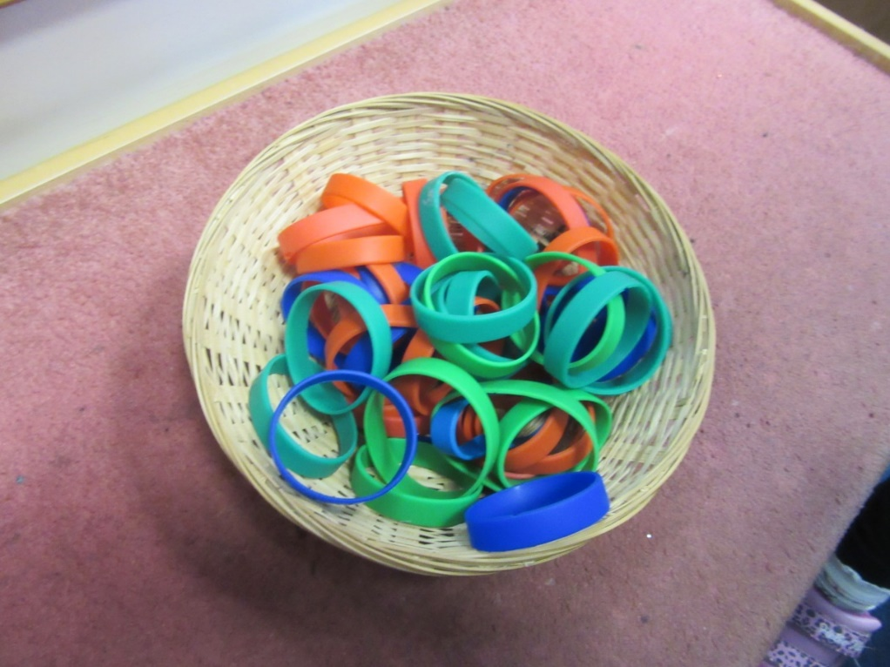
Lunchtime
Children will choose their lunch option at the beginning of the day and wear the correct coloured band. Menus will be available in September so that you can help your child choose their lunch options daily.

Slide 16
Drop off and pick up times:
8:45 drop off
3:20 pick up

Slide 17
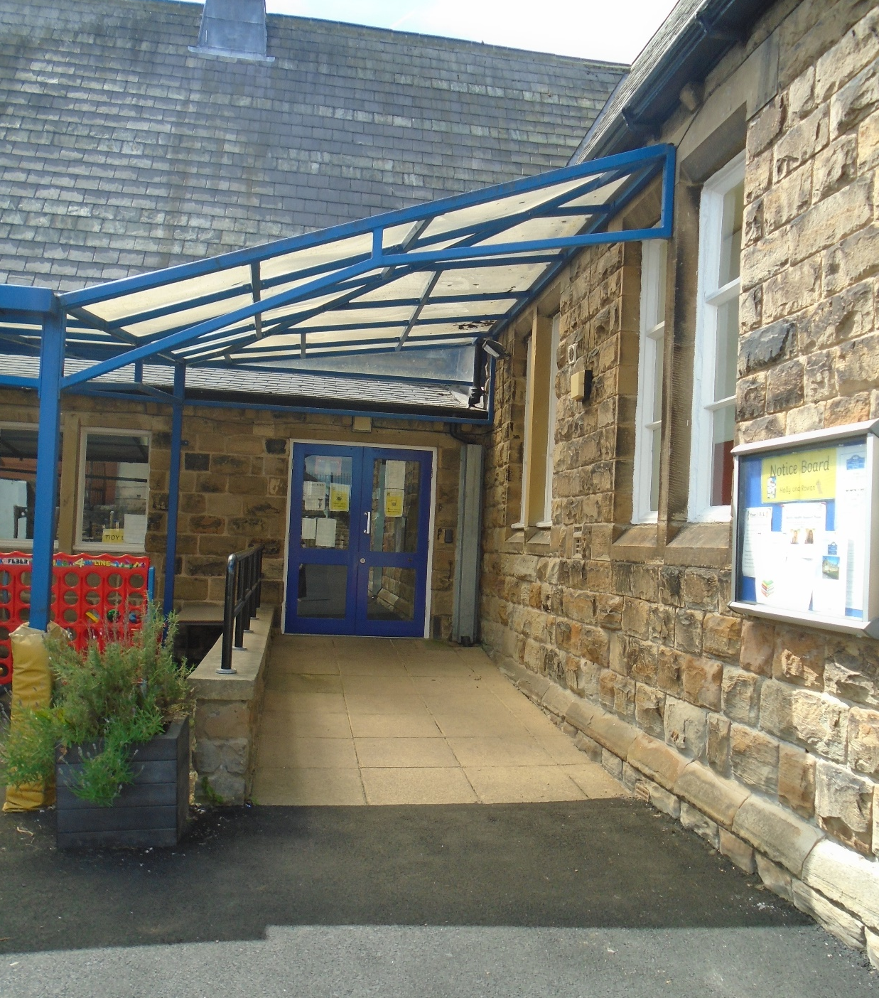
Class door for pick up and drop off

Slide 18
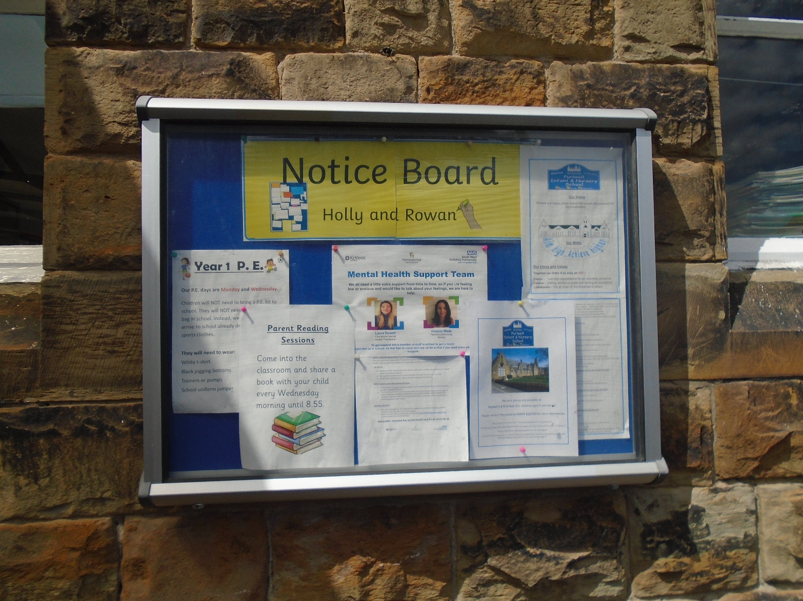
Notice Boards
Please check the notice board for class information and updates.

Slide 19
Home/school partnership
Please make sure the school has an up to date email address for you.
You can contact your child’s teacher by email
Miss Horner
rowan.purlwell@kirkleeseducation.uk
Mr Field
holly.purlwell@kirkleeseducation.uk

Slide 20

Have a great summer. See you in September!
Children to return to school on Wednesday the 6th September
Thank you for attending this meeting

