Slide 1
Year 2
Parent Information
Mrs Taylor
Miss Afsha
Miss Hinchliffe

Slide 2
Welcome and Introduction
Oak Class: Mrs Taylor, Mrs Daji
Willow Class: Miss Hinchliffe and Mr Siddique
Sycamore Class: Miss Afsha and Mrs Bhula

Slide 3
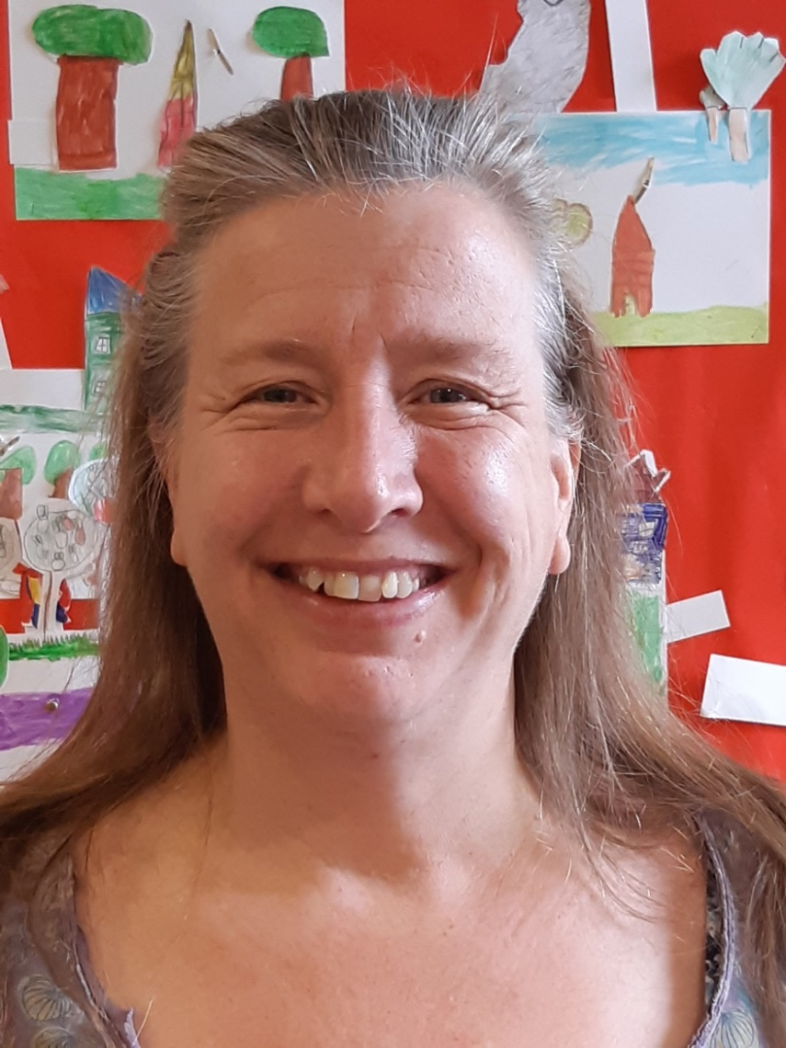
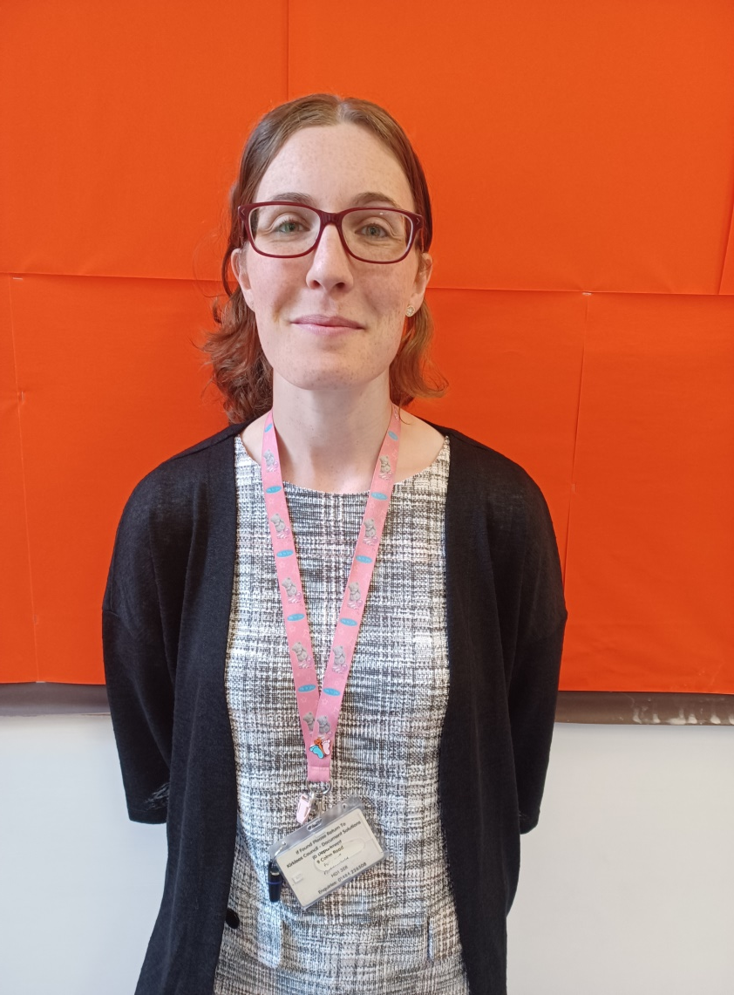
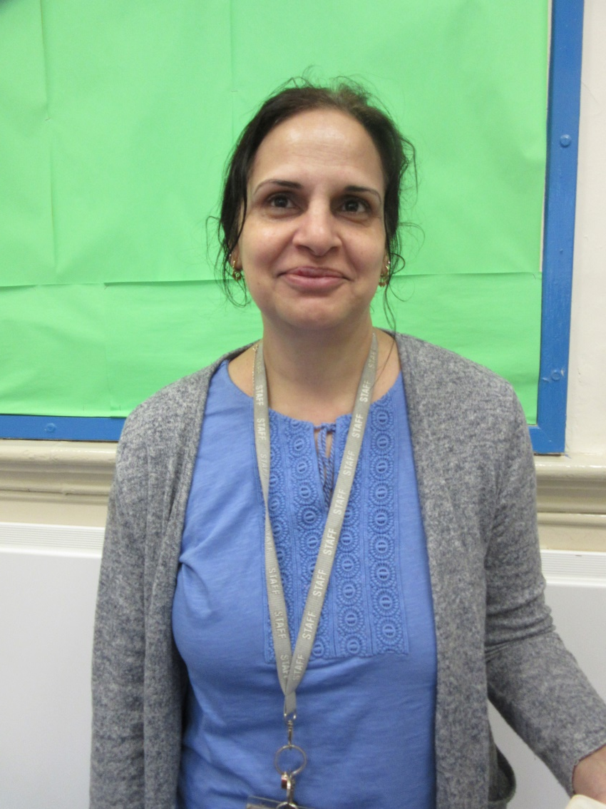

Slide 4
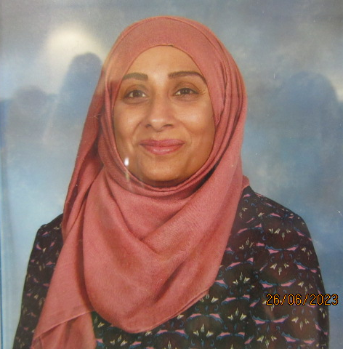
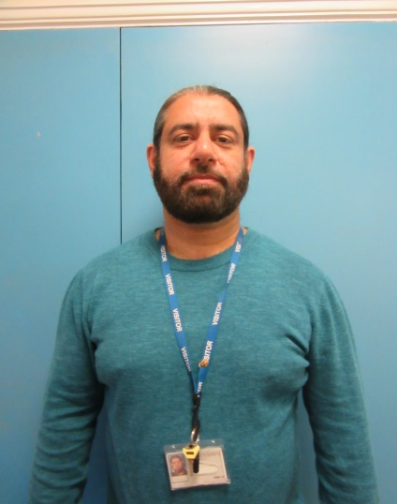
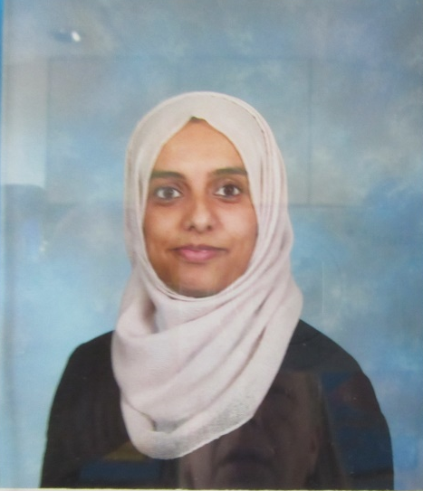

Slide 5
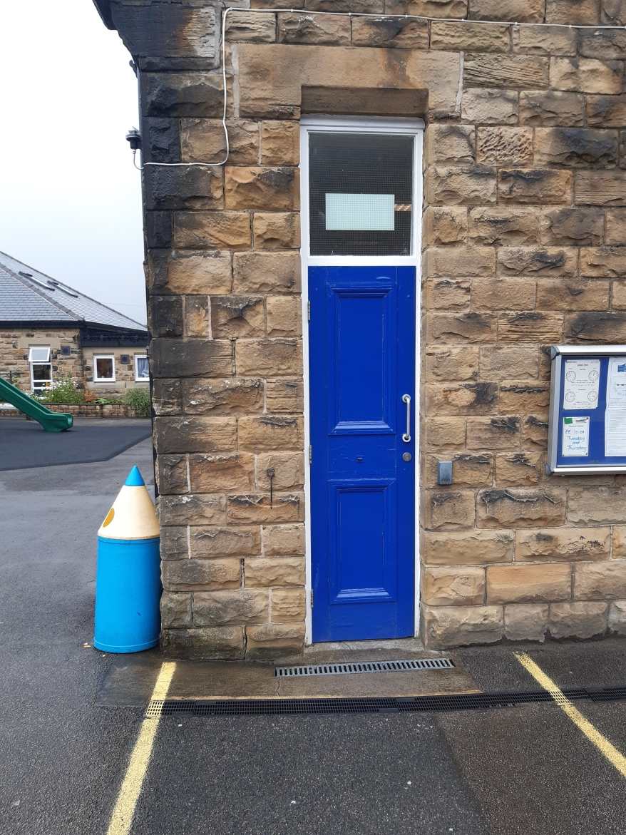
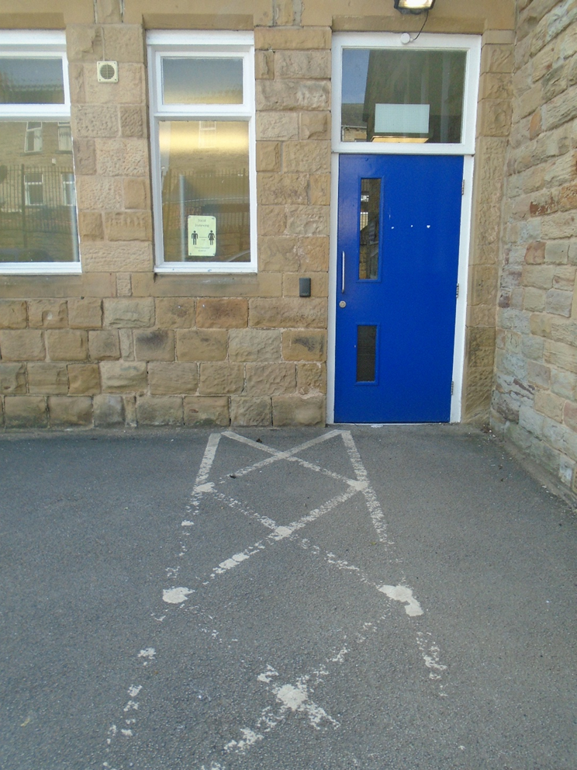
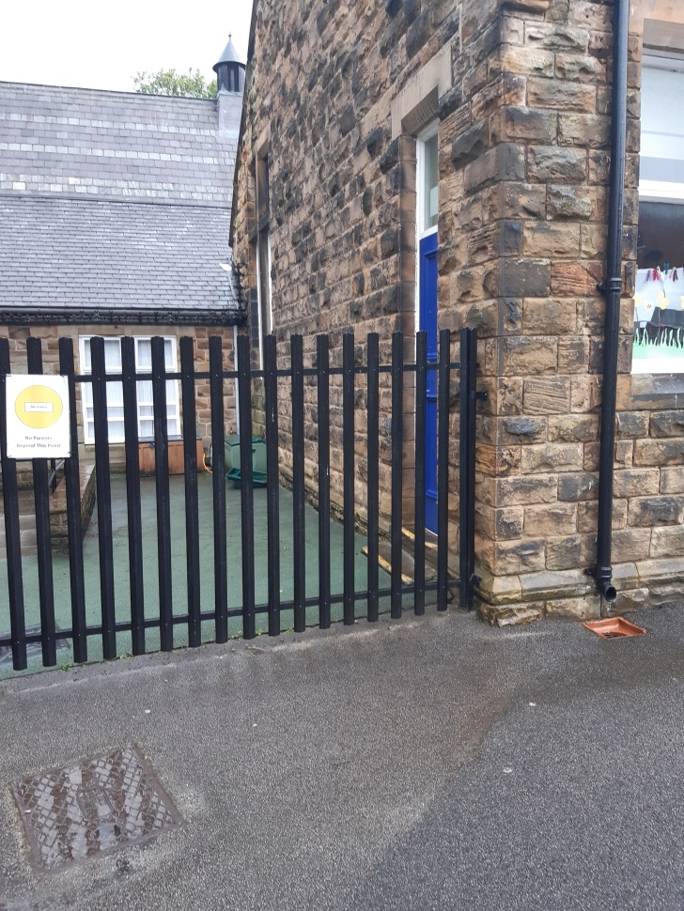
Classrooms

Slide 6
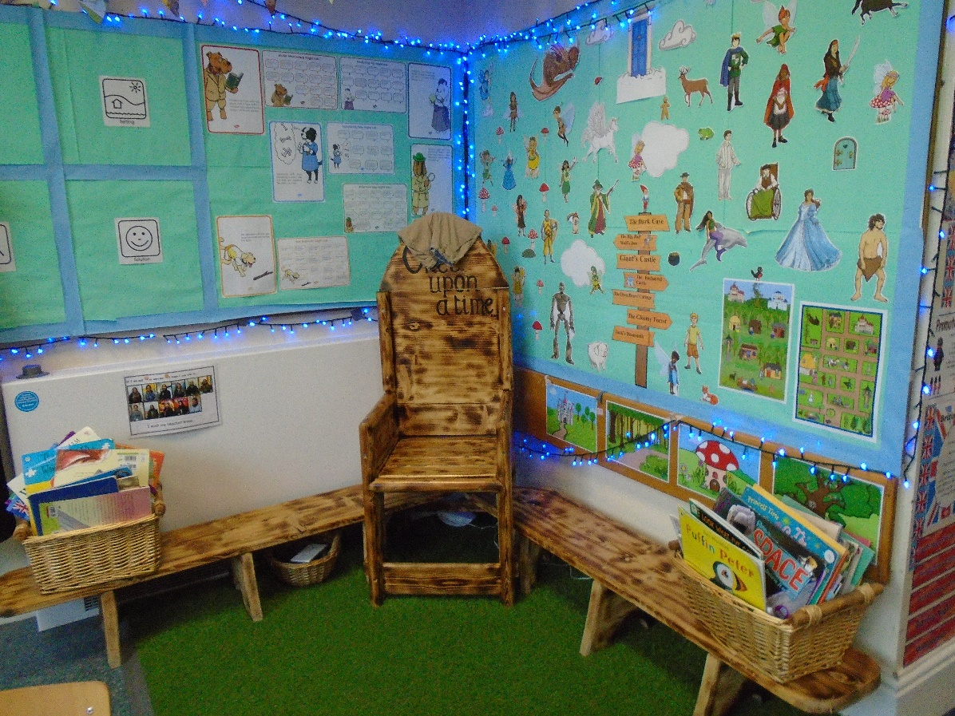
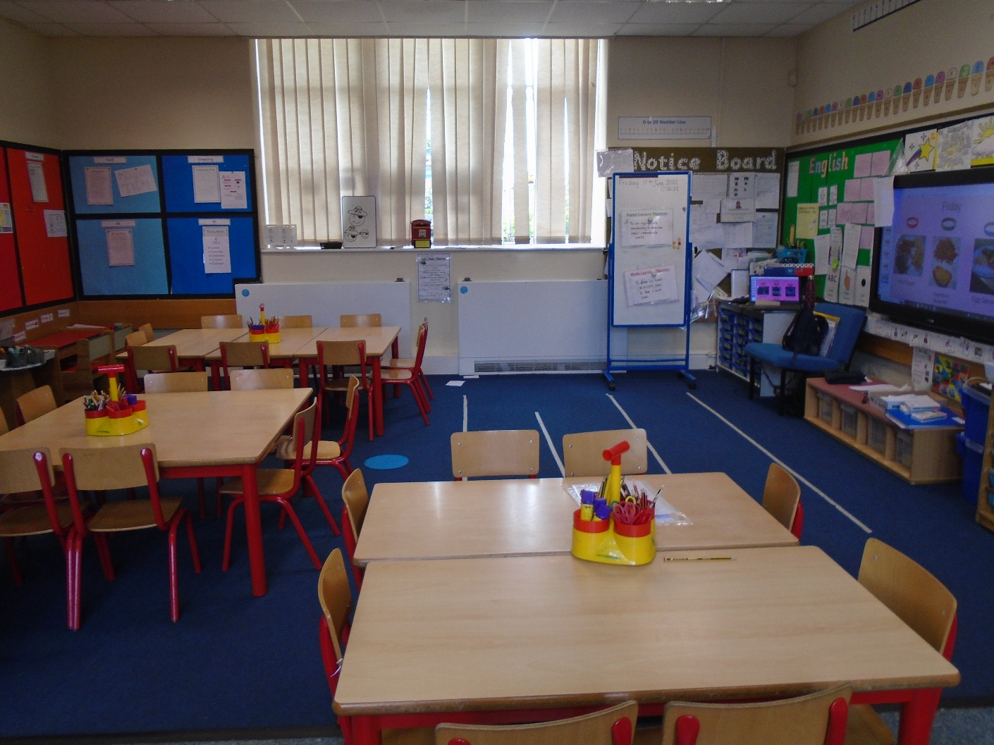
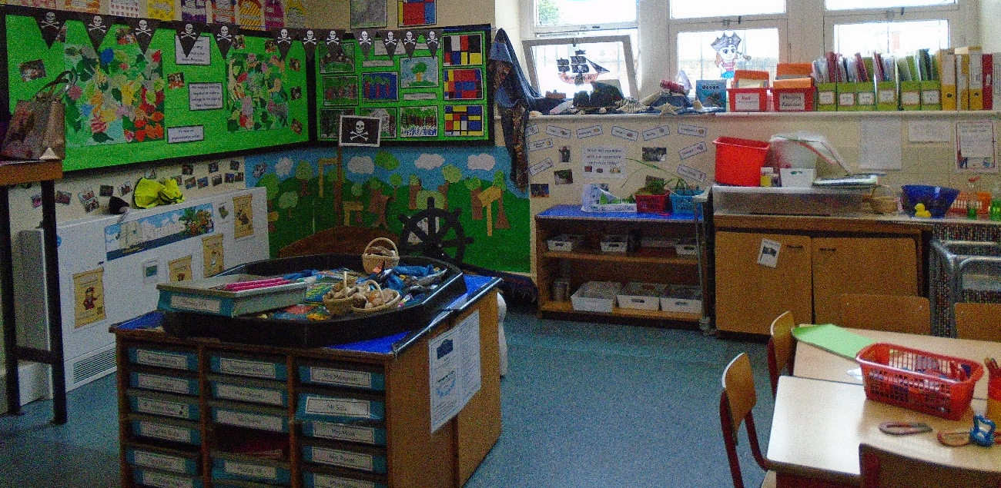
Oak Class

Slide 7
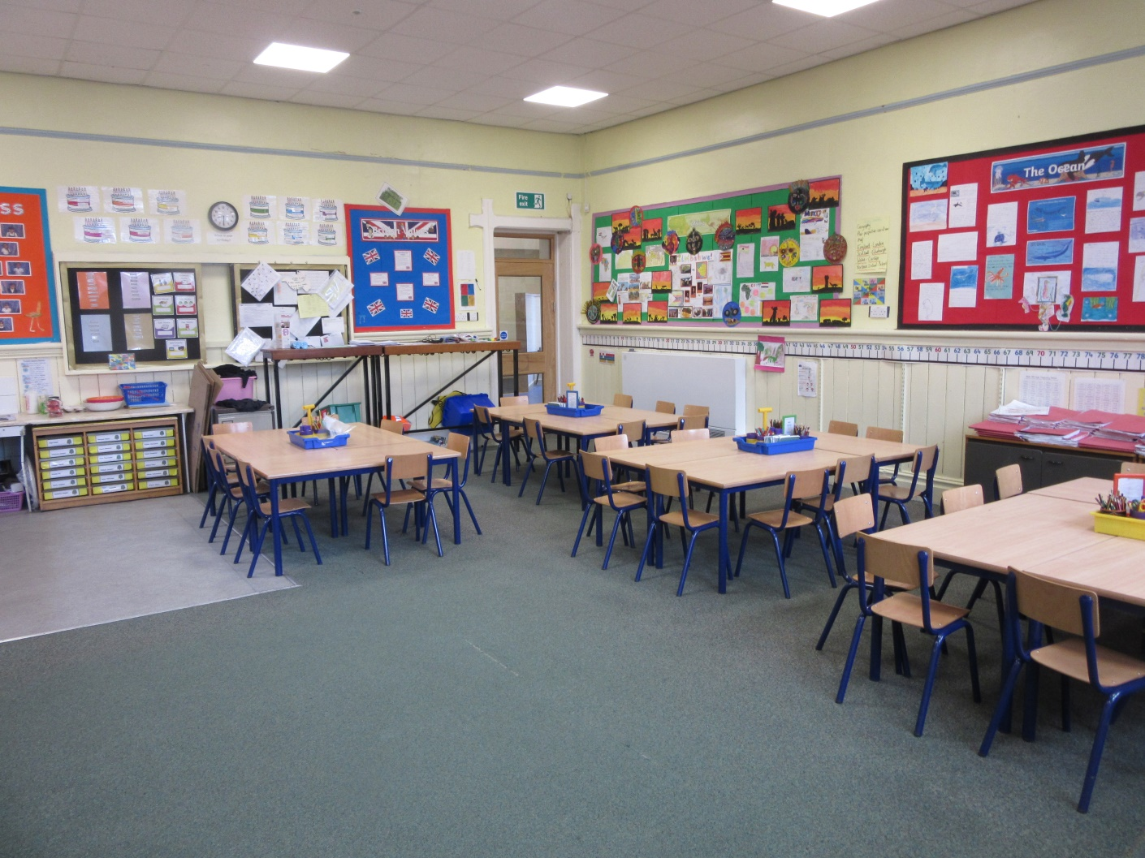
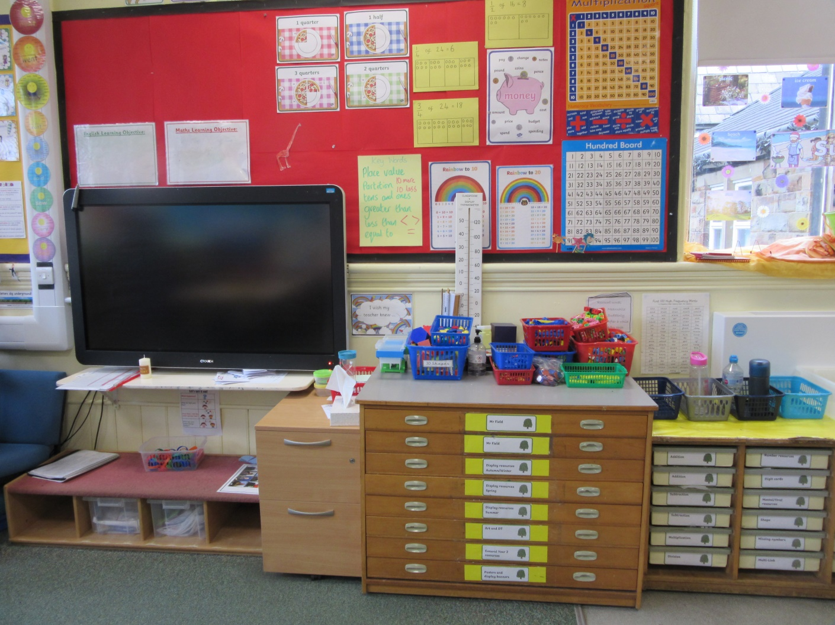
Willow Class

Slide 8
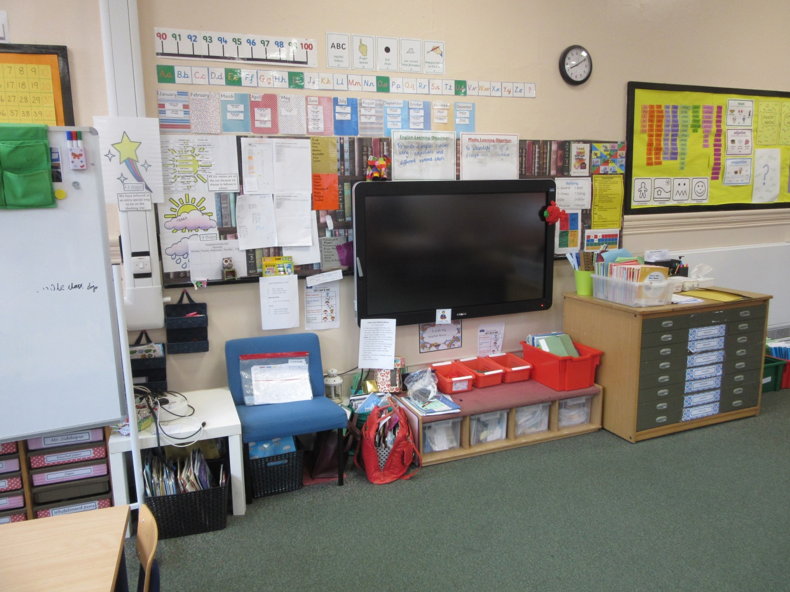
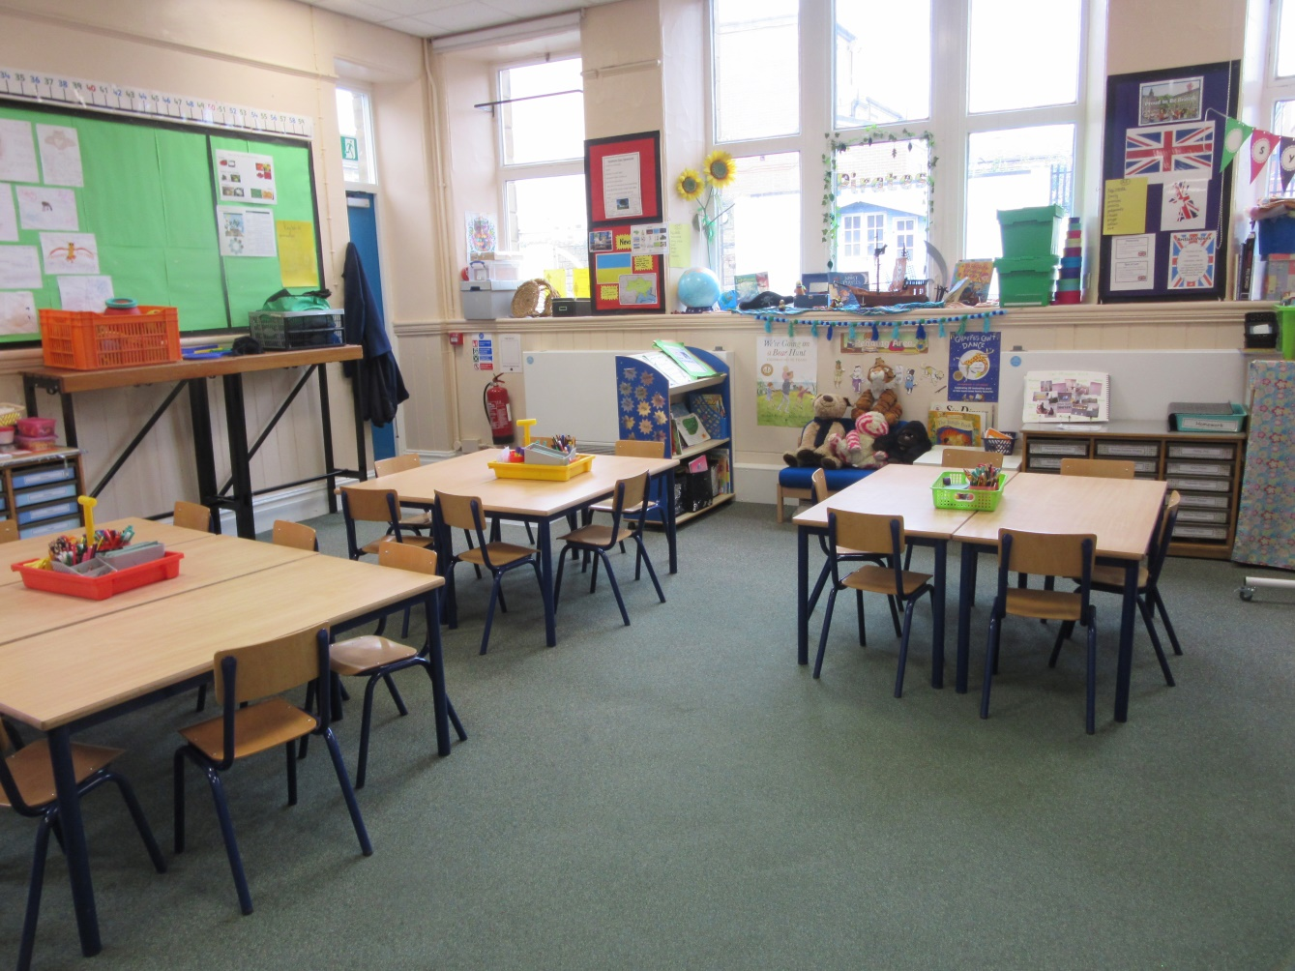
Sycamore Class

Slide 9
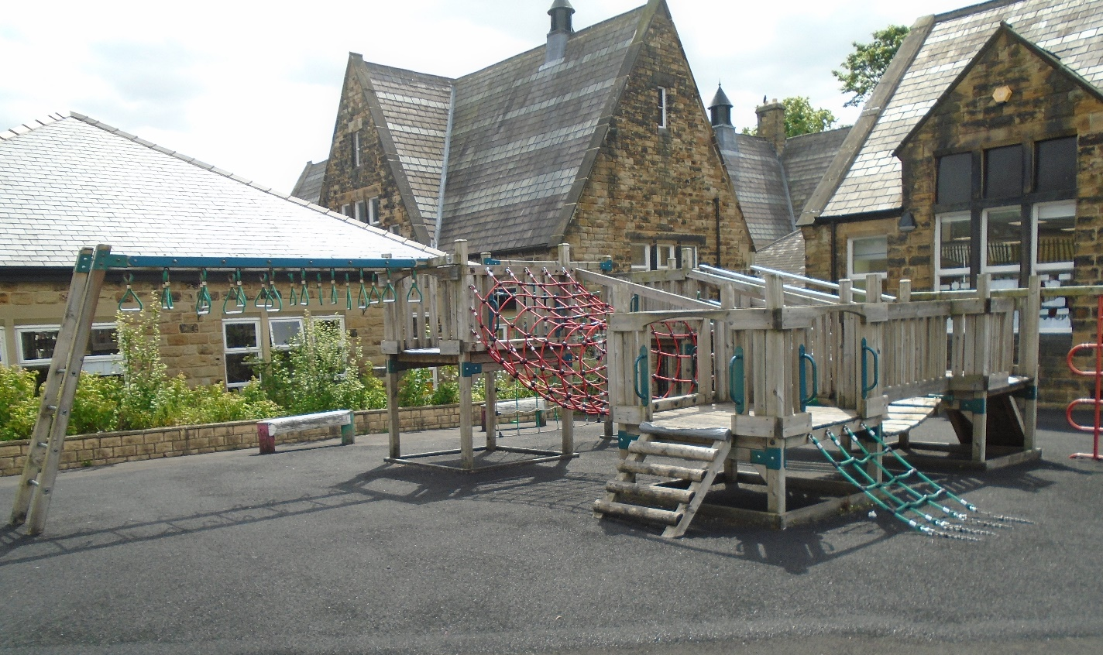
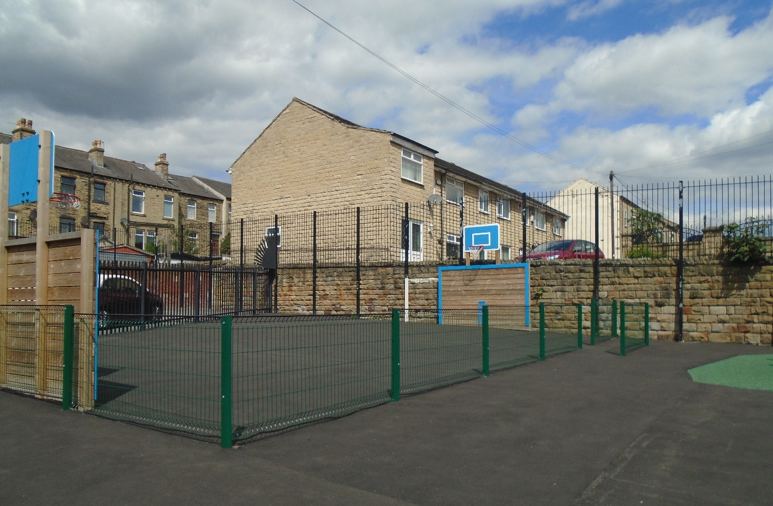
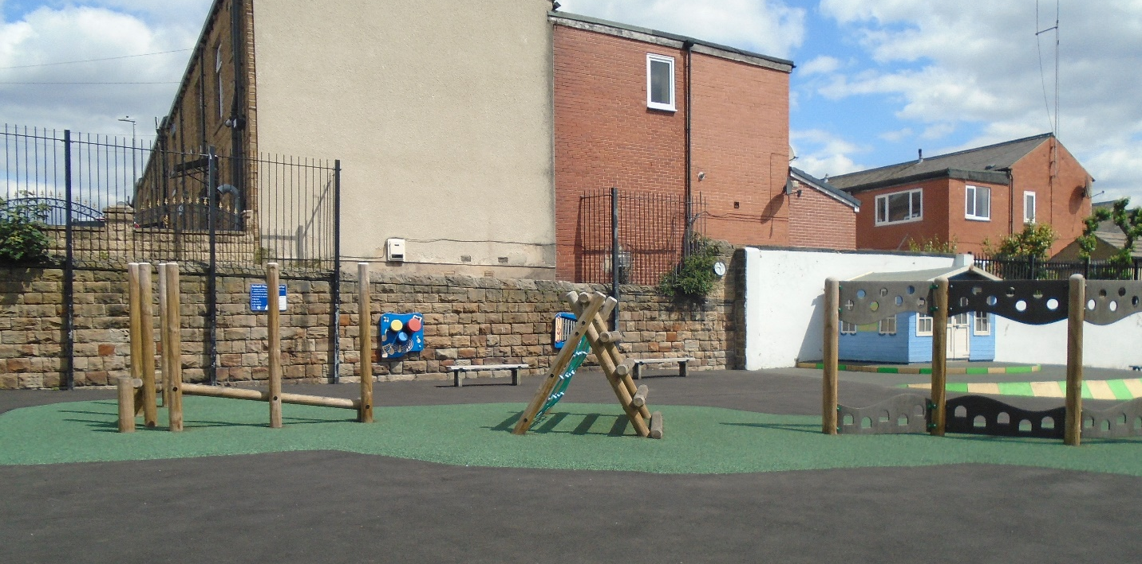
Our Playground

Slide 10
Drop off and pick up:
8.45
3.20

Slide 11
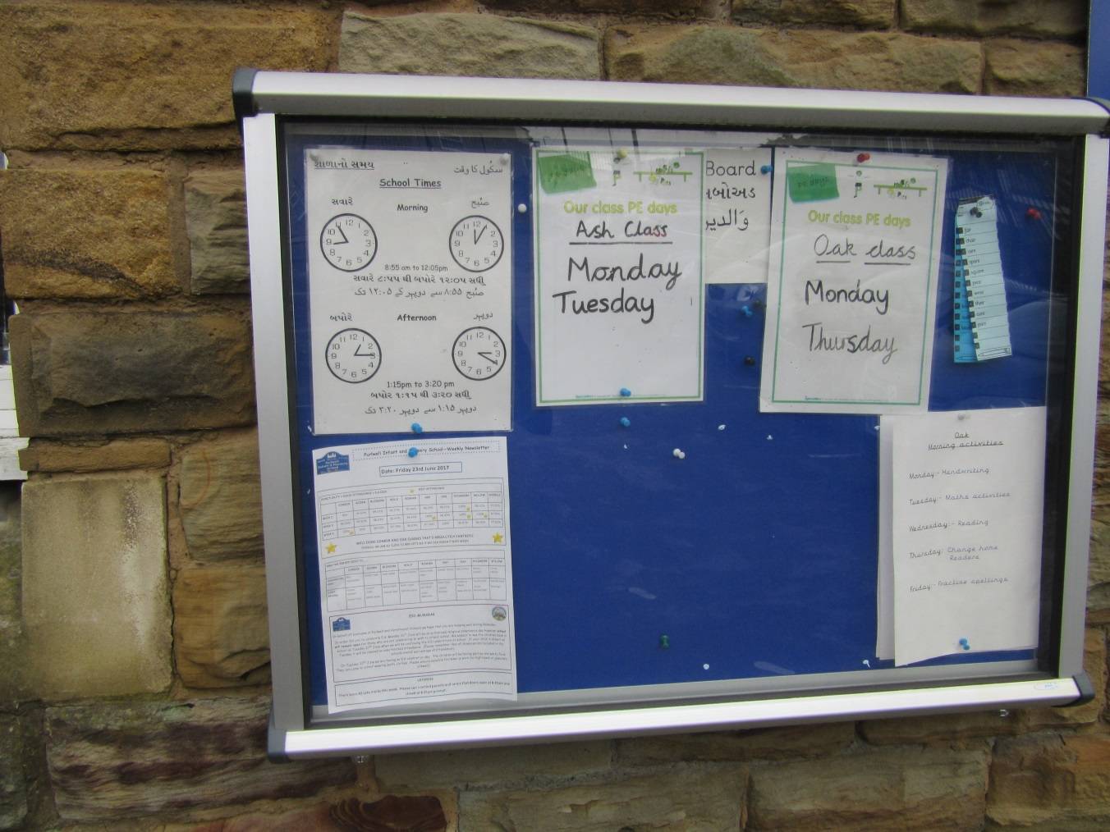
Notice Boards

Slide 12
Things to bring every day
Water bottle
Book bag with reading books and planners

Slide 13
Reading books (Little Wandle book, band book, home reader and library)
Reading records/ planners – these need to be filled in each week at home
Homework book – given out on Friday, please return by the following Wednesday
Spellings – these will be put in their planners each week

Slide 14
Key Stage 1 Curriculum
English
Mathematics
Phonics
Guided Reading
Handwriting
History/Geography
Science
Computing
Art/ DT
PE
RE
Music
PSHE
As you can see, Key Stage 1 has a very busy curriculum. Every school day is important.

Slide 15
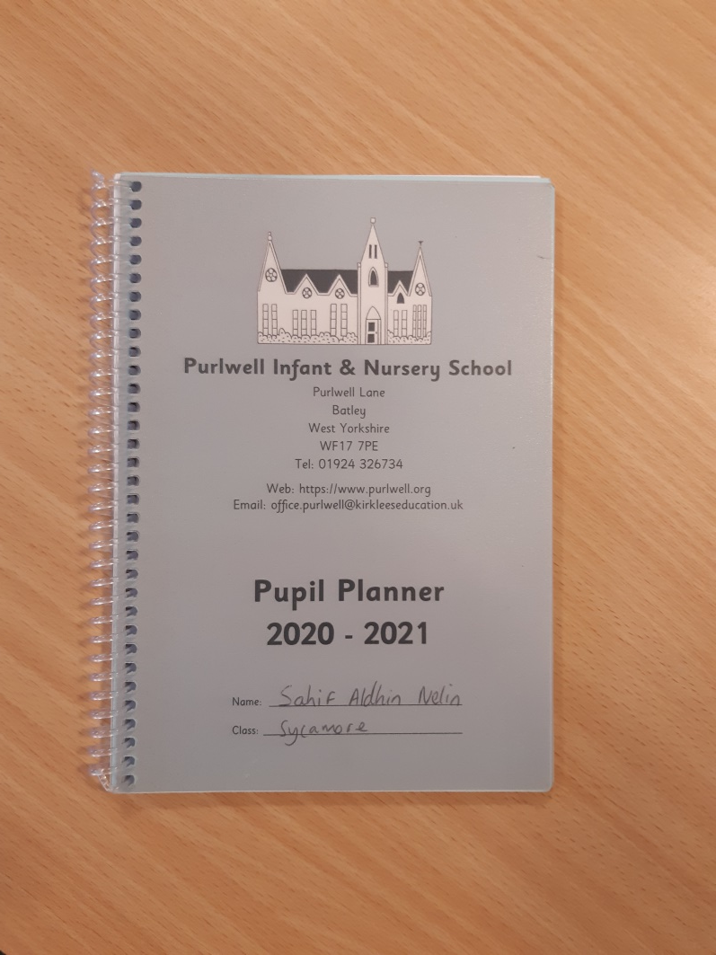
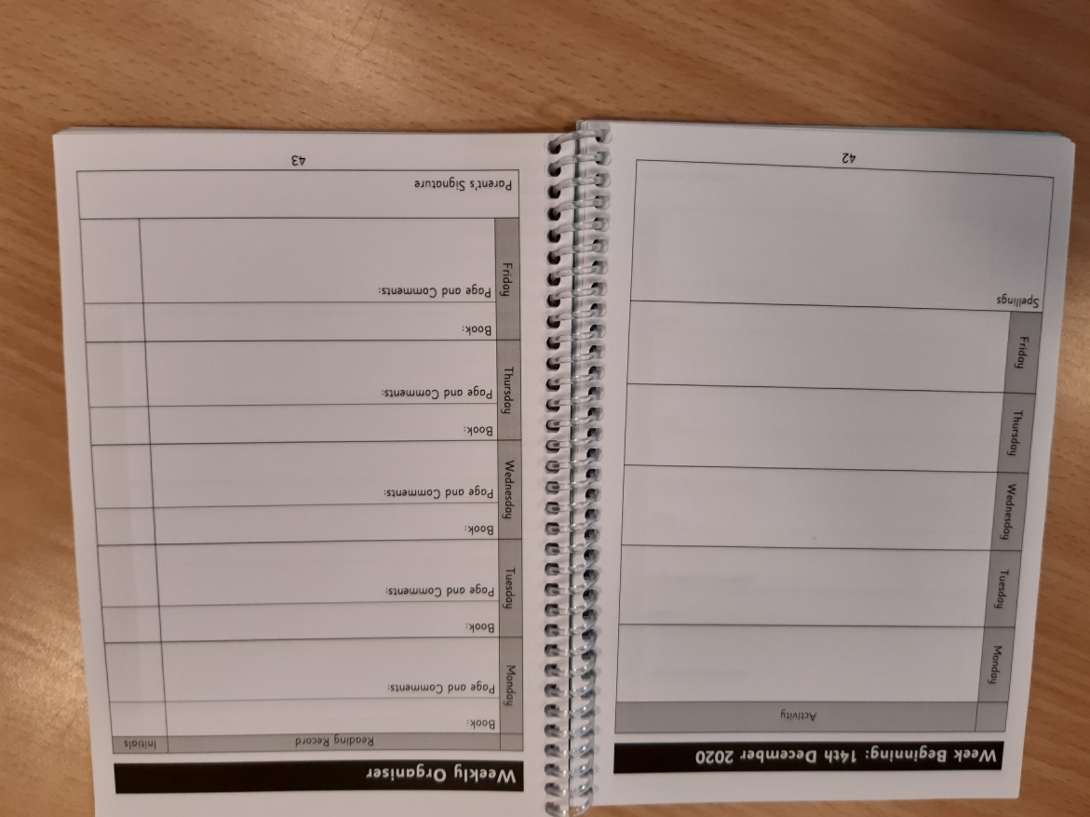
Planners

Slide 16
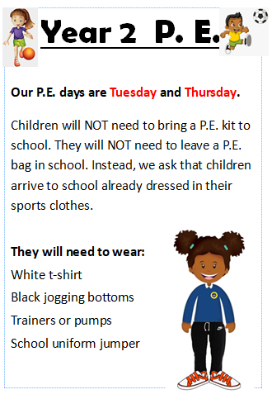
PE (Monday and Wednesday)
This is subject to change- please check the notice board!
PE kit to be worn to school
No earrings
No taweez
No watches

Slide 17
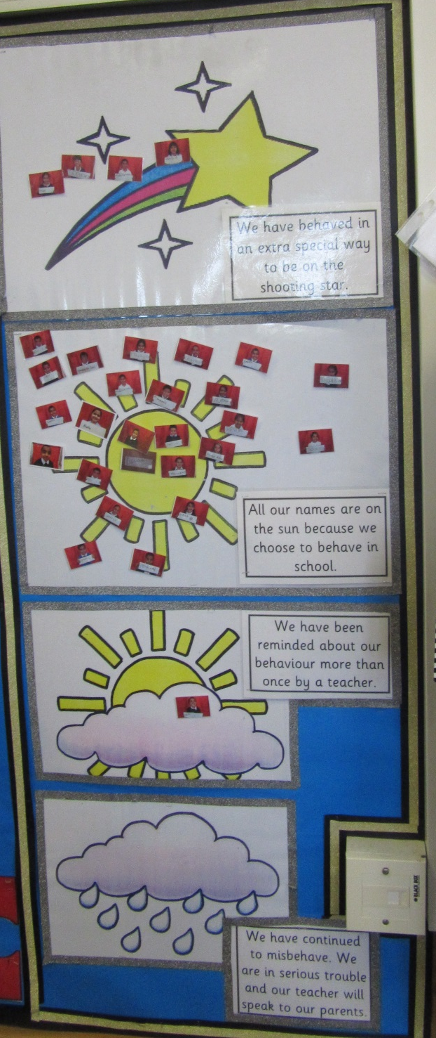
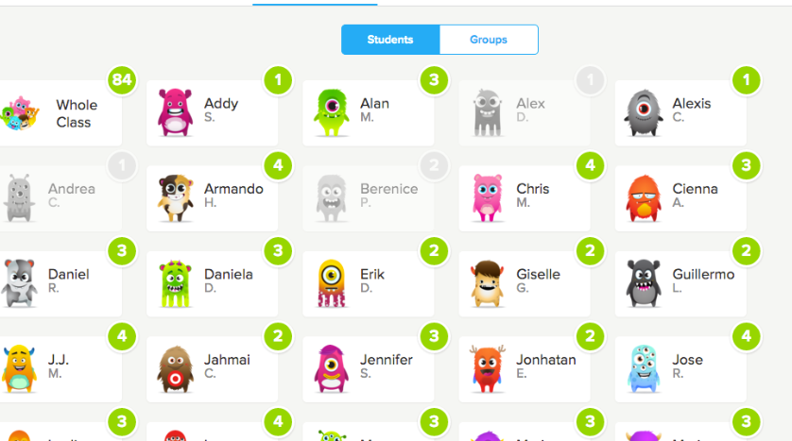
Behaviour System
(Expectations, attitude, behaviour)

Slide 18
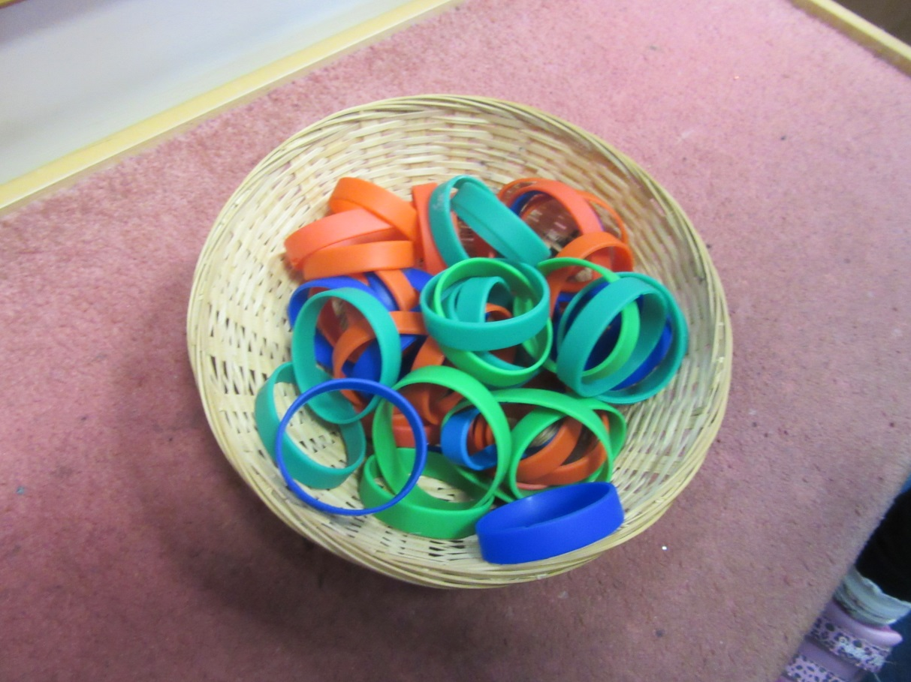
Lunchtime

Slide 19
Year 2 Tests

Slide 20
Home/school partnership
Please make sure school knows an up to date email address for you.
You can contact your child’s teacher by email
Mrs Taylor
oak.purlwell@kirkleeseducation.uk
Miss Hinchliffe
willow.purlwell@kirkleeseducation.uk
Miss Afsha
sycamore.purlwell@kirkleeseducation.uk

Slide 21
Thank You

